Slide 1
Spark Funds – Investment Strategy
Spark funds, an asset management company, is looking for a strategic investment options based on global trends. A solution needs to be drawn keeping below limitations and business objectives in mind.
Limitations:
5 to 15 million USD will be investment per round.
Investment will be only in English speaking countries for ease of communication. Business Objectives:
Identifying best sectors, countries and investment type for making investment.
Extensive analysis of Investment type, sector and country needs to be done.

Slide 2
Strategic Investment Decision – Flow Chart
D
a t a
Data Analysis
Group data on Investment type, Country and Sector
Market Information Files
P
r e p a
r a t i o n
Ignore non- English speaking countries
Is English Speaking Country?
No
Merge Data
Yes
Consider English speaking countries for investment options
Data for Analysis

Slide 3
Problem Analysis
To ideate a workflow we had brainstorming session among team. This led to building up of a stream-lined workflow keeping business objectives in view and understanding data.
Understanding Data:
Companies – this dataset has information about companies and their categories Rounds – Investment preferences of the companies. Like amount, investment type, etc.,
On high level following are stages in the workflow:
Gather data for the analysis
Clean the data for readability
Collate data in to a model
Filter model based on Investment type, Country and Sector
Identify best possible investment options
Plot on the option for graphical representation.
Account for missing mappings in the mapping file.
Tools for the workflow:
RStudio is used for data cleansing and modelling
Tableau is used for plotting the results

Slide 4
Data Model Analysis
Data quality is crucial for this step. We have companies, rounds and mapping information in files. This needs to be cleansed and built into a model.
Building model RStudio is extensively used and following stages are addressed in building model:
Data Import – Import data from files.
Data Cleansing –Removing or correcting dirty data. Handling of NA values.
Data Merging – Merge companies and investment round data to get fully readable dataset based on unique key.
Data Mapping – Mapping dataset for identifying sectors and investment preferences and also define the missing mappings by mapping the primary sectors to the nearest logical main sector.
Filtering – To identify preferred investment options for Spark Funds to invest.
Exporting Data – For tableau plotting data is exported.
Model Objectives – based on above model following are the primary goals.
Investment type analysis: ability to identify best suited categories for the investment.
Country Analysis: list out countries having most investment in the past.
Sector Analysis: understanding investment distribution among sectors.

Slide 5
Result Analysis
Based on the model created and studied, below are the representations done. Spark Funds can easily deduce required results form the mode.
Identify unique companies and handle NA values for raised_amout_usd
List average funding for each of investment types. (Venture, Angel, Seed and Private Equity type).
Country-wise funding in sectors for any chosen investment type. List top 9 countries for investment type chosen.
List top 3 English speaking countries for identifying investment-friendly options.
Sector-wise investment in each country. Total number of investments and total value of investment in USD.
Top, second and third best sectors based on count of investments.
Number of investments in top, second and third best sectors.
Which companies received highest investment in top and second best sectors.
Graphical representation done in Tableau and displayed in next sections of the presentation.

Slide 6
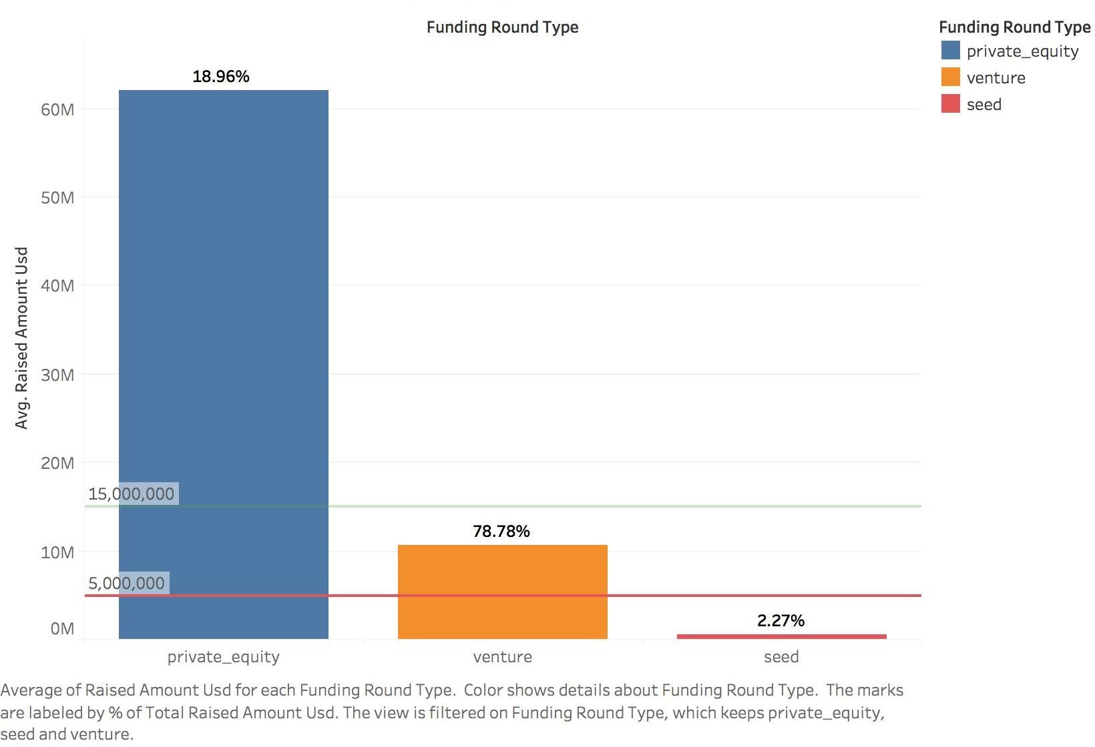
Investments based on Funding Type (FT)

Slide 7
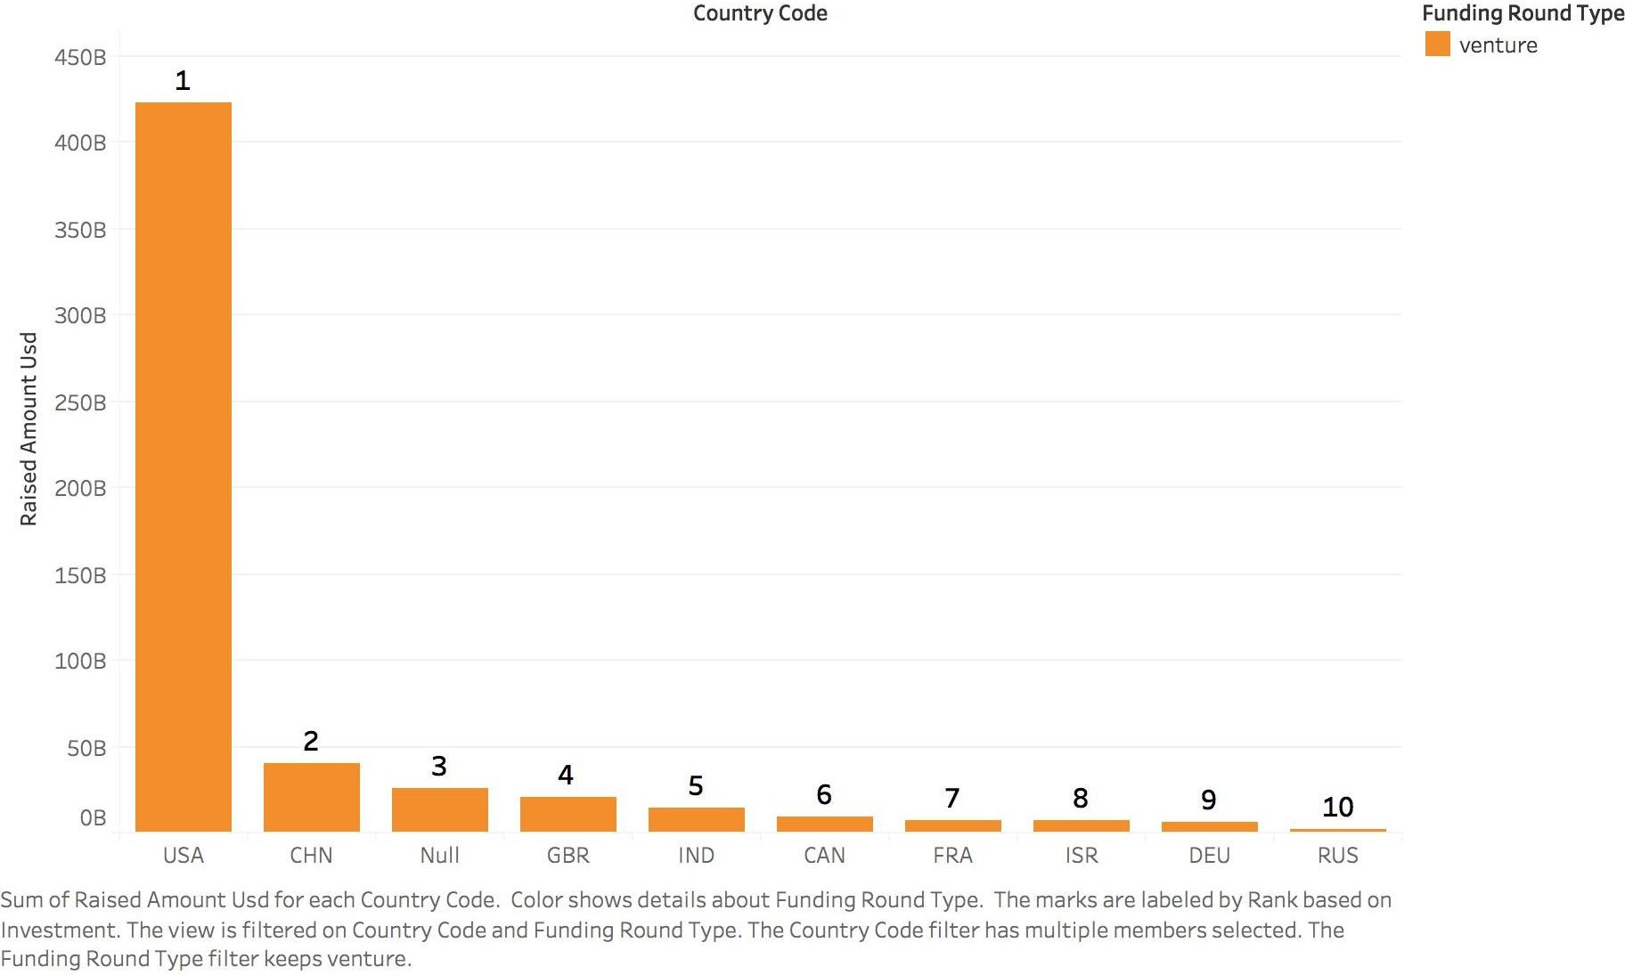
Total amount of investments among top 9 countries

Slide 8
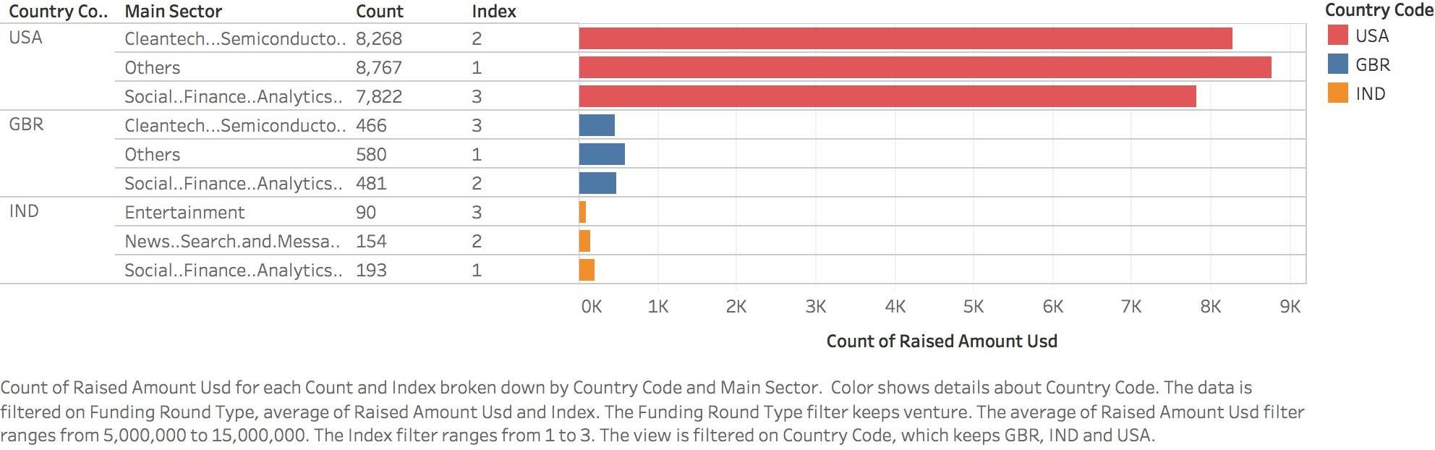
Number of Investments in top 3 sectors among preferred countries

Slide 9
Inferences
Based on analysis, Spark fund should invest in the following countries:
Invest in countries | Investment Sectors
USA | Others Cleantech/Semiconductors Social/Finance/Analytics/Advertising
GBR (Great Britain) | Others Social/Finance/Analytics/Advertising Cleantech/Semiconductors
India | Social/Finance/Analytics/Advertising News, Search and Messaging Entertainment

